Slide 1
Data Processing and Visualization
Redwan Ahmed Rizvee
https://rizveeredwan.github.io

Slide 2
Contents
Data object and attribute types: nominal, binary, ordinal, numeric
Basic statistical descriptions of data
Measuring data similarity and dissimilarity
Data preprocessing: cleaning, integration, transformation, and discretization
Data visualization techniques:
Pixel-oriented
Geometric projection
Icon-based
Hierarchical visualization

Slide 3
Data object and attribute types
A data object represents an entity (e.g., a person, a product, a transaction) in the dataset. Each object is described using a set of attributes (also known as features, variables, or fields).
Example: For a student object: {Name: "Alice", Gender: "Female", Grade: "A", Age: 21} Here, each piece of information is an attribute.

Slide 4
Attribute Types
a. Nominal
Definition: Categorical data with no inherent order.
Examples:
Gender: Male, Female
Color: Red, Blue, Green
Department: HR, Sales, Engineering
b. Binary
Definition: Special case of nominal attribute with only two categories.
Types:
Symmetric: Both values are equally important. Example: isMarried = {Yes, No}
Asymmetric: One value is more important. Example: hasDisease = {Yes, No} (Yes is more significant)
Values: Often encoded as 0 and 1

Slide 5
Attribute Types
c. Ordinal
Definition: Categories that have a meaningful order, but no fixed distance between them.
Examples:
Education level: High School < Bachelor < Master < PhD
Customer satisfaction: Low, Medium, High
Operations: Can rank but not do arithmetic on theme
d. Numeric (Quantitative)
Divided into two subtypes:
Interval: Ordered, meaningful differences, but no true zero → Example: Temperature in Celsius (20°C - 10°C = 10°C, but 0°C ≠ no temperature)
Ratio: Ordered, meaningful differences, and true zero exists → Example: Age, Height, Weight, Salary (0 = absence)

Slide 6
Basic statistical descriptions of data
1. Measures of Central Tendency
These describe the center or average of the data.
Mean (Average): Mean= ∑ x_{i} / N; Sum of all values divided by the number of values.
Median: The middle value when data is sorted. For even-sized data, it's the average of the two middle values.
Mode: The most frequently occurring value in the dataset.

Slide 7
Basic statistical descriptions of data
2. Measures of Dispersion (Spread)
These describe how much the data varies.
Range: Range=Max−Min
Variance: Average of the squared differences from the mean. Variance=∑(x_{i}-x̄)²/n (for population) and Variance = ∑(x_{i}-x̄)²/(n-1) (for sample)
This denominator correction is done to correct the biasness, known as Bessel’s correction
Standard Deviation (SD): Square root of the variance; gives dispersion in the same unit as the data.
Interquartile Range (IQR): IQR=Q3−Q1, Q1 (First Quartile) = Median of the data between (0-50%) and Q3 (Third Quartile) = Median of the data between (50-100)% Measures the spread of the middle 50% of the data.

Slide 8
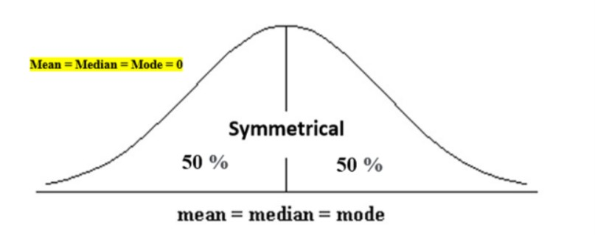
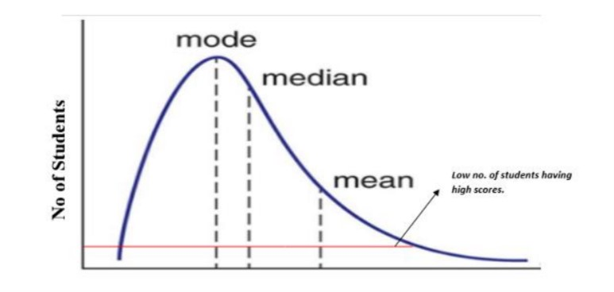
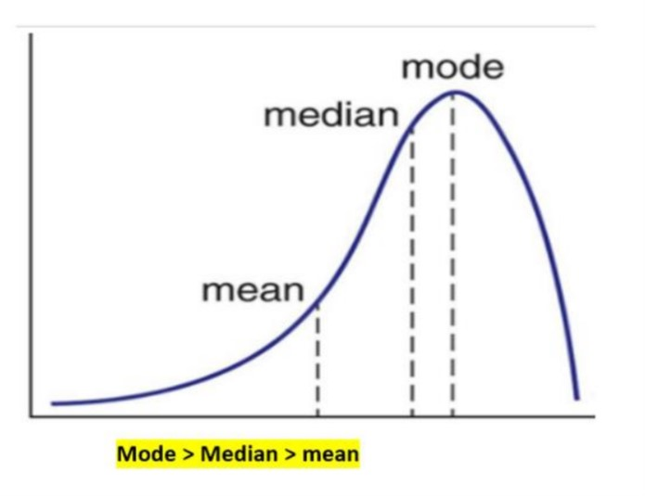
Basic statistical descriptions of data
3. Shape of the Distribution
Skewness: Indicates asymmetry of the data distribution.
Positive skew: tail on the right
Negative skew: tail on the left
Kurtosis: Measures "tailedness" or the presence of outliers.
High kurtosis: heavy tails (outliers)
Low kurtosis: light tails

Slide 9
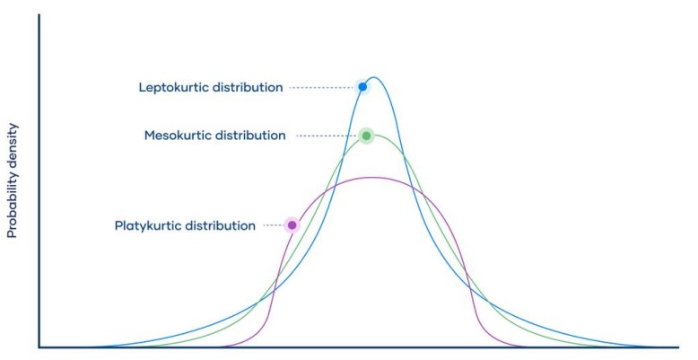
Basic statistical descriptions of data
Kurtosis:
Kurtosis is a statistical measure that quantifies the shape of a probability distribution. It provides information about the tails and peakedness of the distribution compared to a normal distribution. Positive kurtosis indicates heavier tails and a more peaked distribution, while negative kurtosis suggests lighter tails and a flatter distribution. Kurtosis helps in analyzing the characteristics and outliers of a dataset.
Leptokurtic (Kurtosis > 3)
Mesokurtic (Kurtosis = 3)
Platykurtic (Kurtosis < 3)
Source

Slide 10
Measuring data similarity and dissimilarity
Similarity: A numerical measure of how alike two data objects are. Higher values mean more similarity.
Dissimilarity: A numerical measure of how different two data objects are. Higher values mean more dissimilarity.

Slide 11
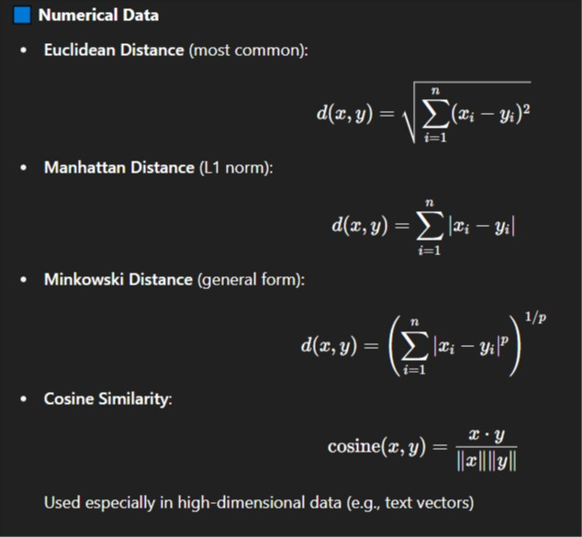
Distance Measures
Euclidian: continuous numerical data, same scale or have been normalized
Manhattan: numerical data with outliers, avoid squaring differences due to creating more gaps
Minkowski: generalized distance function that includes both Euclidean (p=2) and Manhattan (p=1), tune the sensitivity to large differences by adjusting ppp
Data is high-dimensional and sparse (many zeros).

Slide 12
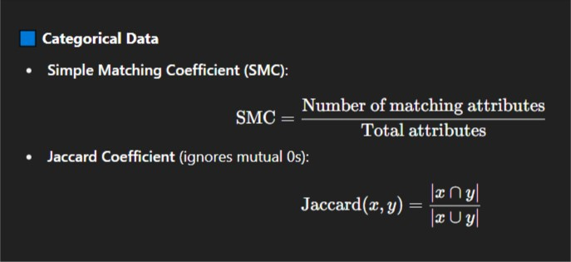
Distance Measures
SMC: categorical or binary features, Presence and absence are equally important, symmetric comparison
Jaccard: categorical or binary features, consider presence more than absence, Asymmetric features

Slide 13
Distance Measures
Ordinal Data
Convert to ranks, then use numeric distance measures (e.g., Euclidean on ranks).
Binary Data
Symmetric Binary (e.g., gender):
Use Hamming Distance or Jaccard.
Asymmetric Binary (e.g., disease presence):
Use Jaccard Coefficient.

Slide 14
Example: Jaccard Similar
Example (Binary Case)
Two binary vectors:
A = [1, 0, 1, 1, 0]
B = [1, 1, 0, 1, 0]
We interpret them as sets of positions where value is 1:
A = {1, 3, 4}
B = {1, 2, 4}
Then:
A∩B={1,4} → size = 2
A∪B={1,2,3,4} → size = 4
Jaccard Similarity=2/4=0.5, Jaccard Distance=1−0.5=0.5
Example (Set-based Example)
A = {"apple", "banana", "cherry"}
B = {"banana", "cherry", "date", "fig"}
Then:
A∩B={"banana","cherry"} → size = 2
A∪B={"apple","banana","cherry","date","fig"}→ size = 5
Jaccard Similarity=2/5=0.4
Jaccard Distance=1−0.4=0.6
* Jaccard Only Focuses only on positive matches

Slide 15
Data Preprocessing: Cleaning
🔹 Techniques:
Handling missing values:
Ignore the record (if rare)
Fill with mean/median/mode
Use interpolation or ML models
Noise reduction:
Smoothing (e.g., binning, regression)
Outlier detection
Standardization:
Ensure uniform formats (dates, case, units)
Deduplication:
Identify and remove duplicate rows
1. Data Cleaning
✅ Purpose:
To remove inaccuracies, inconsistencies, missing values, and noisy data.
🔹 Common Problems:
Missing values (e.g., blank cells in a CSV)
Noisy data (e.g., typos, outliers)
Inconsistent formatting (e.g., "BD", "Bangladesh", "bangla desh")
Duplicate entries

Slide 16
Data Integration
2. Data Integration
✅ Purpose: To combine data from multiple sources into a coherent dataset.
🔹 Scenarios:
Merging data from: Multiple databases, Internal and external systems, IoT devices + business logs
🔹 Challenges:
Schema integration: Same concept may use different names (e.g., "Cust_ID" vs "CustomerID")
Entity resolution: Matching same real-world entity (e.g., "John Smith" vs "J. Smith")
Redundancy: Repeated data from different sources
Data conflicts: Conflicting values for the same attribute
🔹 Techniques:
Use metadata and domain knowledge for schema alignment
Apply record linkage / entity matching algorithms
Use ETL tools for scalable integration

Slide 17
Data Transformation
Purpose:
To convert data into a suitable format for analysis or mining.
🔹 Common Methods:
Normalization/Standardization: Scale numerical values to a common range (e.g., [0,1] or z-scores)
Attribute construction: Derive new meaningful features (e.g., Age = CurrentYear - BirthYear)
Encoding categorical variables: One-hot encoding, label encoding
Aggregation: Summarizing data (e.g., total monthly sales from daily data)
Smoothing: Reduce noise via averaging or regression
Generalization: Replace low-level data with high-level concepts (e.g., “25” → “Young Adult”)

Slide 18
Data Discretization
Purpose:
To convert continuous attributes into categorical ones.
🔹 Why Needed:
Some models (e.g., decision trees) perform better with categorical input.
To simplify patterns or enhance interpretability.
🔹 Methods:
Equal-width binning: Divide range into intervals of equal size
Equal-frequency binning: Each bin has the same number of records
Cluster-based discretization: Use clustering (e.g., k-means) to form bins
Entropy-based (e.g., in decision trees): Discretization based on class information gain

Slide 19
Data visualization techniques: Pixel-oriented
Every data value is mapped to a colored pixel on the screen. Very useful for large-scale multidimensional data. Uses color intensity or hue to encode data values. Efficient for datasets with millions of data points.
Techniques: Recursive Pattern, Circle Segments, Spiral Pixel Displays, etc.
Example:
Heatmap visualization using seaborn

Slide 20
Data Visualization Technique: Geometric Projection
Projects high-dimensional data onto a 2D or 3D geometric space using mathematical transformations. Preserves structure such as clusters, distances, or relationships.
Techniques: Scatter Plots (for 2D/3D), Parallel Coordinates, Principal Component Analysis (PCA), t-SNE, UMAP (nonlinear dimensionality reduction)
Scatterplot visualization using seaborn

Slide 21
Data Visualization Technique: Icon-based
Each data item is represented by a small icon, where icon features (shape, size, color, angle, etc.) encode attribute values.
Techniques: Chernoff Faces (facial features represent data dimensions), Star Glyphs or Radar Charts (spokes or arms encode attributes), Stick Figures

Slide 22
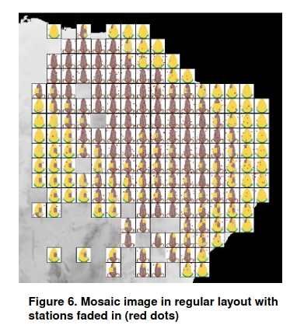
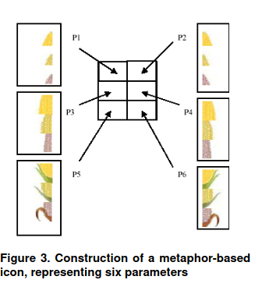
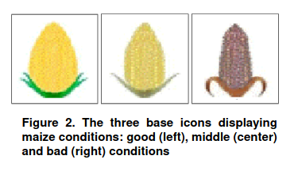
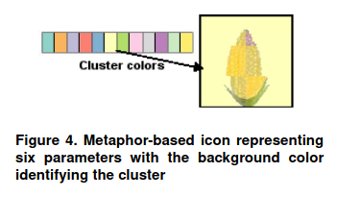
Data Visualization Technique: Icon-based
Source

Slide 23
Data Visualization Technique: Hierarchical Visualization
Designed to represent hierarchical (tree-like or nested) data structures.
🔹 Techniques: Tree Maps, Dendrograms, Radial Trees, Sunburst Charts
Tree map visualization using plotly
Dendogram visualization using plotly

Slide 24
Questions?

